Slide 1
Government Intervention
Ref. Pindyck & Rubinfeld

Slide 2


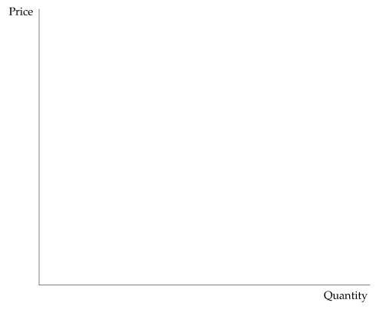
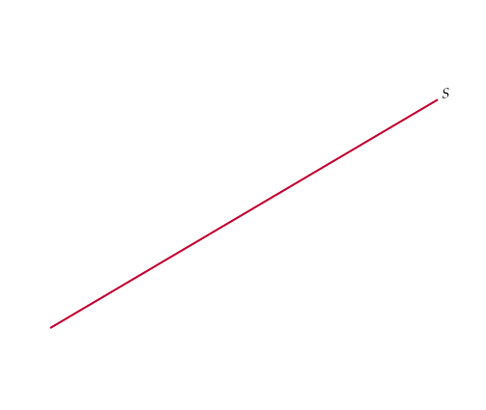
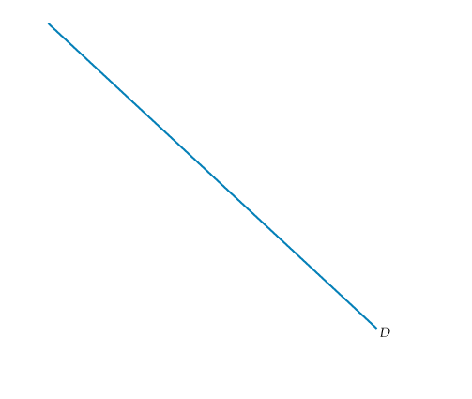
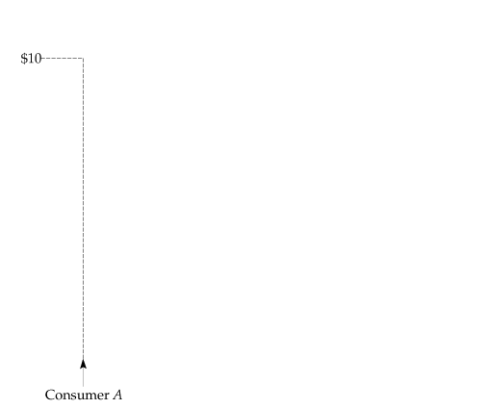
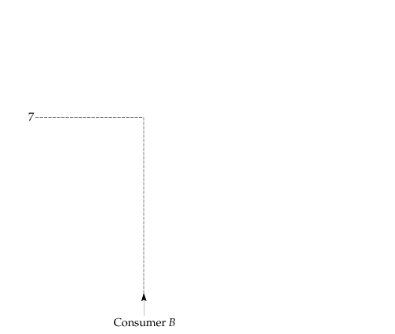
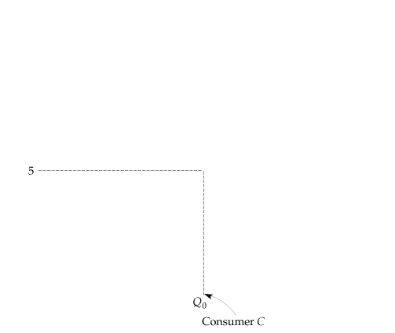
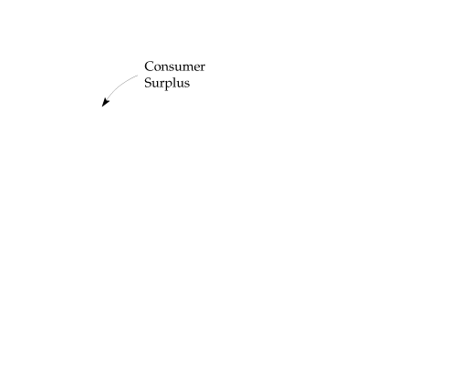
Consumer and Producer Surplus
Consumer A would pay $10 for a good whose market price is $5 and therefore enjoys a benefit of $5.
Consumer B enjoys a benefit of $2,
and Consumer C, who values the good at exactly the market price, enjoys no benefit.
Consumer surplus, which measures the total benefit to all consumers, is the yellow-shaded area between the demand curve and the market price.

Slide 3
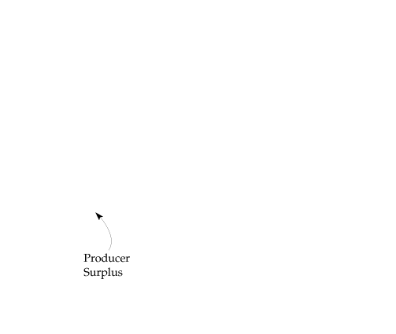

EVALUATING THE GAINS AND LOSSES FROM GOVERNMENT POLICIES— CONSUMER AND PRODUCER SURPLUS
Producer surplus is the green-shaded area between the supply curve and the market price.
Together, consumer and producer surplus measure the welfare benefit of a competitive market.

Slide 4


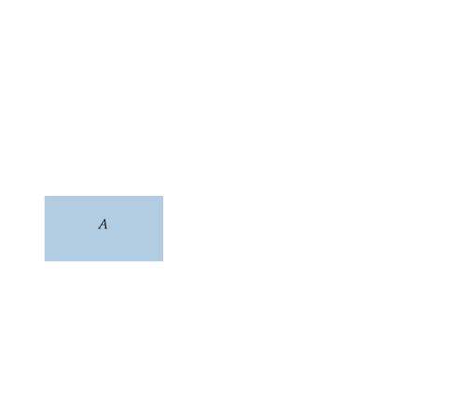
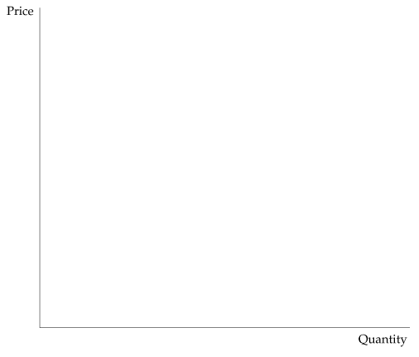
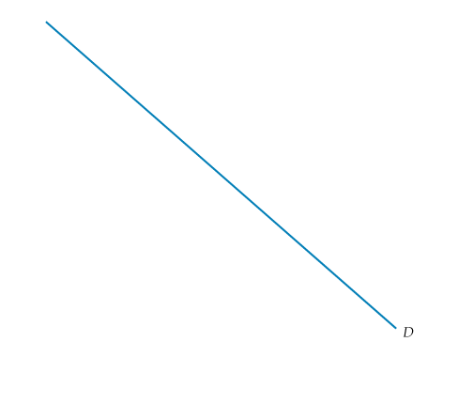
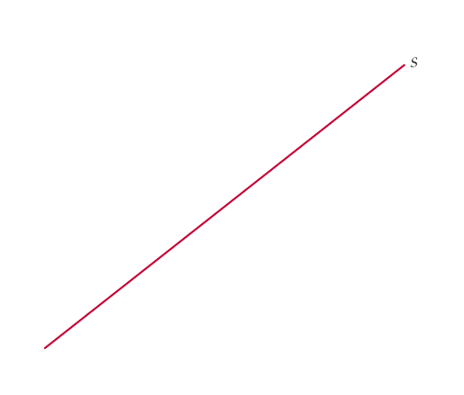
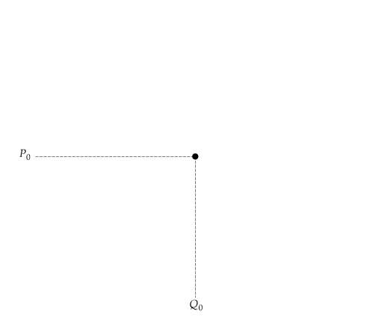

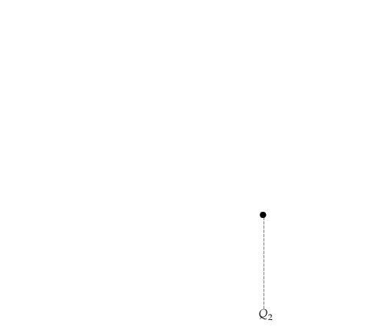
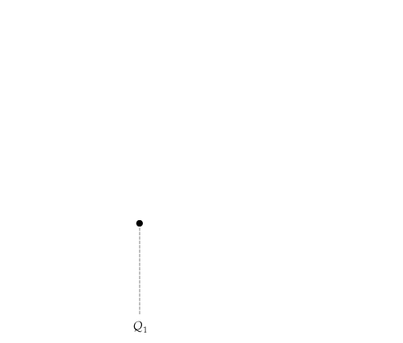
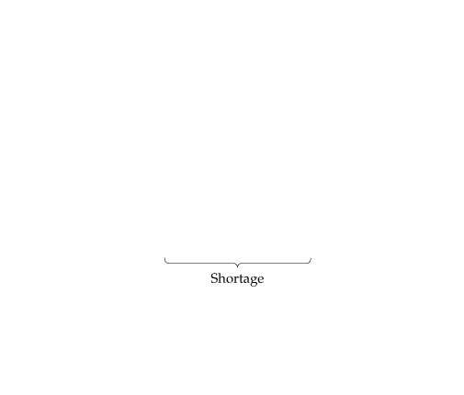
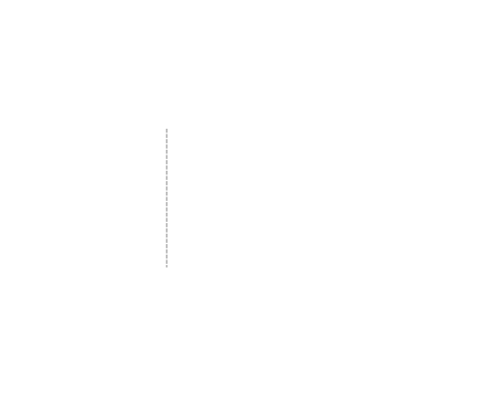
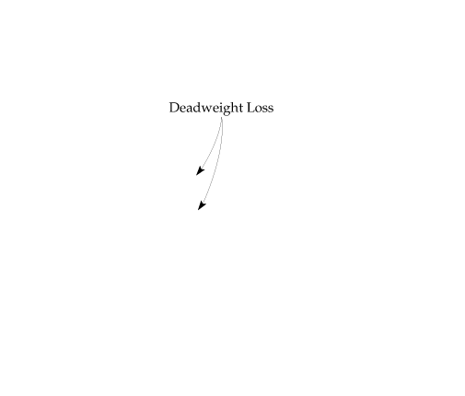
Change in Consumer and Producer Surplus from Price Controls
● welfare effects Gains and losses to consumers and producers.
● deadweight loss Net loss of total (consumer plus producer) surplus.
The price of a good has been regulated to be no higher than P_{max}, which is below the market-clearing price P₀.
The gain to consumers is the difference between rectangle A and triangle B.
The loss to producers is the sum of rectangle A and triangle C.
Triangles B and C together measure the deadweight loss from price controls.

Slide 5


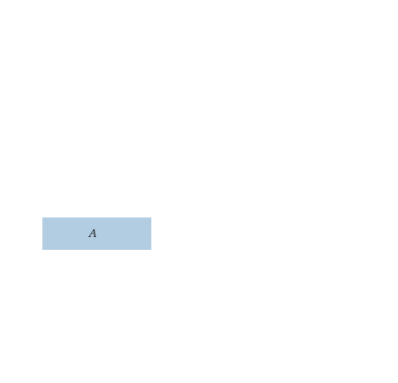
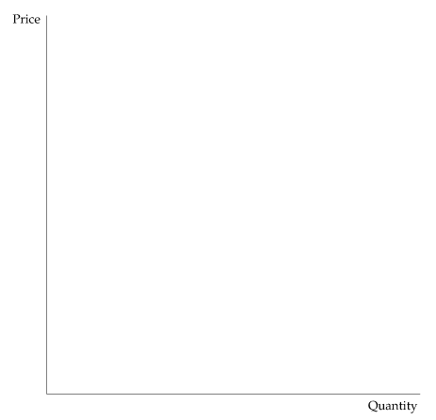
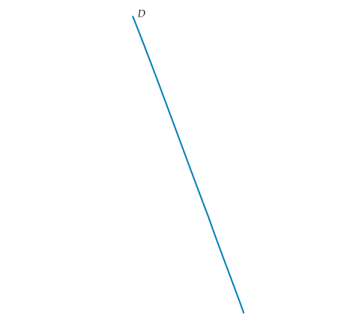
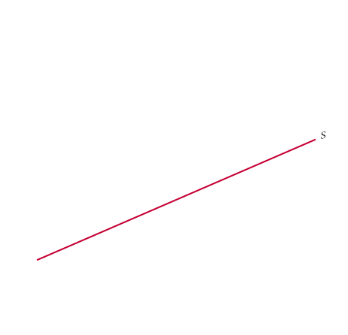
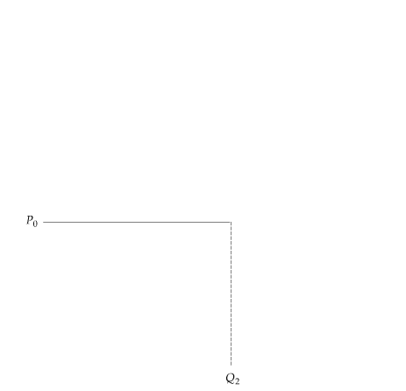



Effect of Price Controls When Demand Is Inelastic
If demand is sufficiently inelastic, triangle B can be larger than rectangle A. In this case, consumers suffer a net loss from price controls.

Slide 6
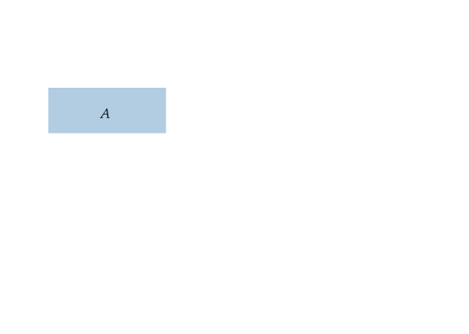
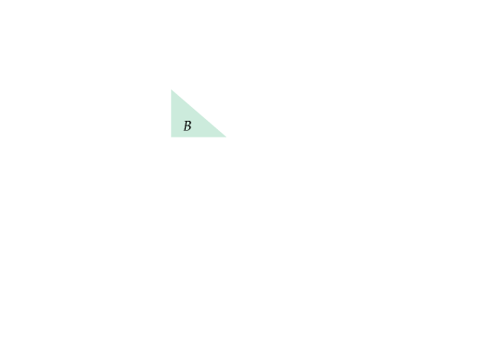

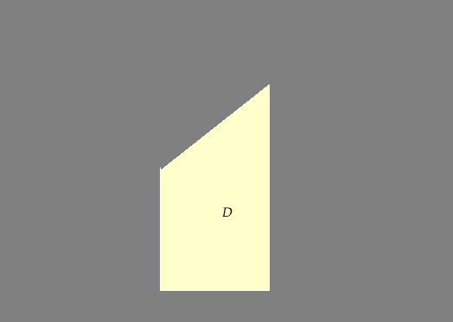
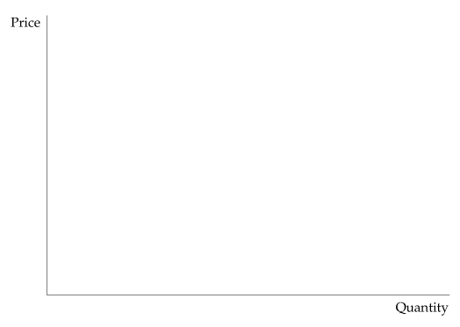
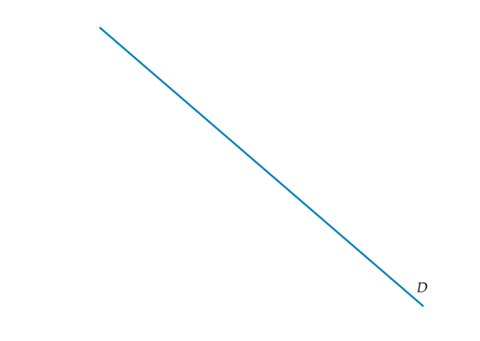
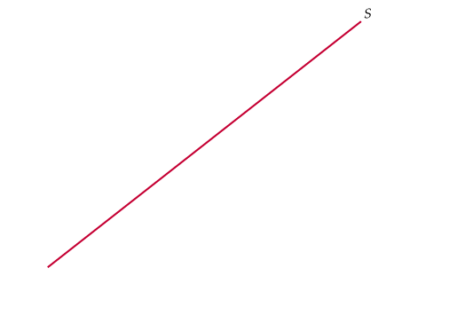
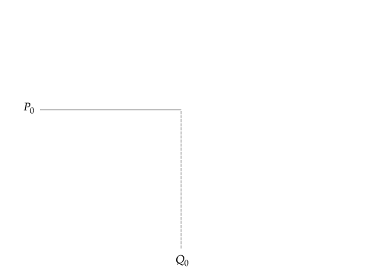
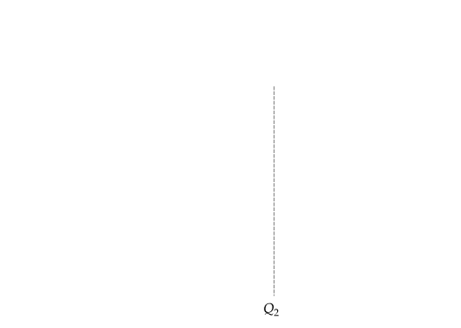
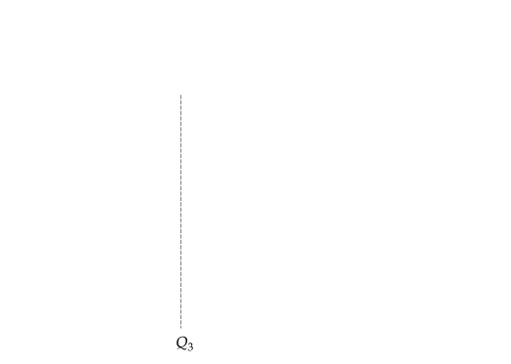

MINIMUM PRICES
Price is regulated to be no lower than P_{min}.
Producers would like to supply Q₂,
but consumers will buy only Q₃.
If producers indeed produce Q₂, the amount Q₂ − Q₃ will go unsold and the change in producer surplus will be A − C − D. In this case, producers as a group may be worse off.

Slide 7
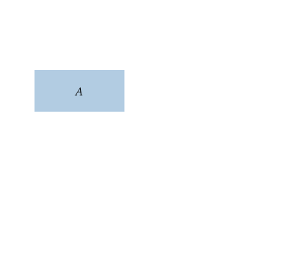
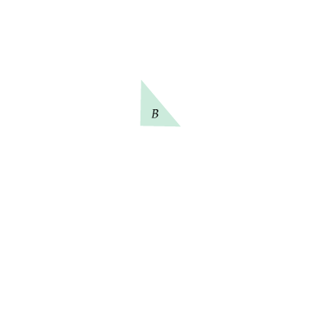

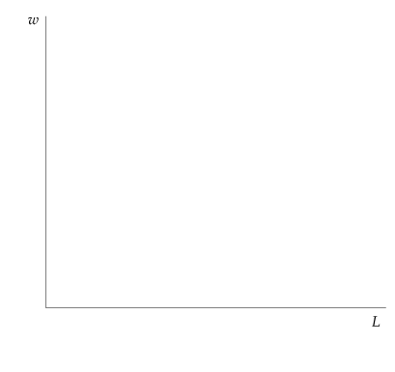
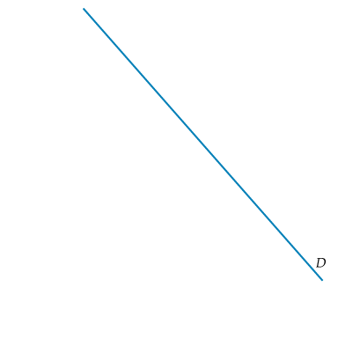
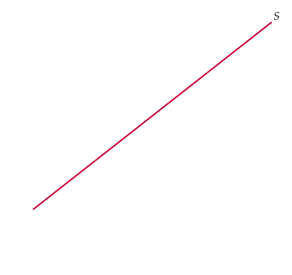
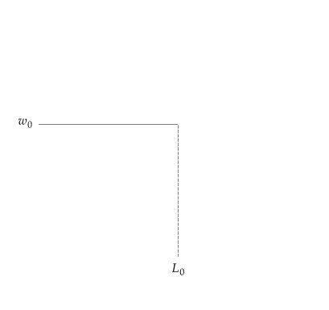
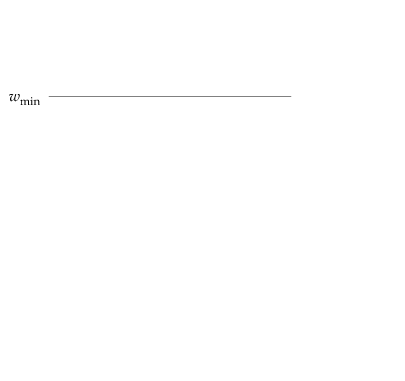
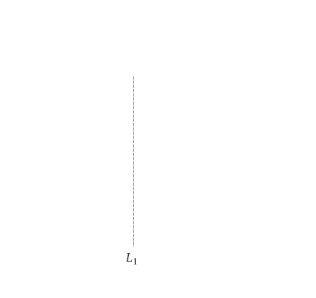
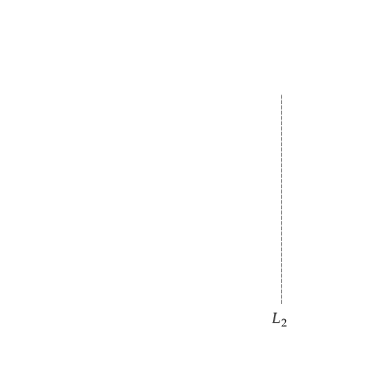
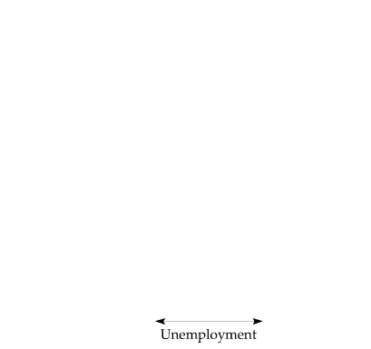
The Minimum Wage
Although the market-clearing wage is w₀,
firms are not allowed to pay less than w_{min}.
This results in unemployment of an amount L₂ − L₁
and a deadweight loss given by triangles B and C.

Slide 8


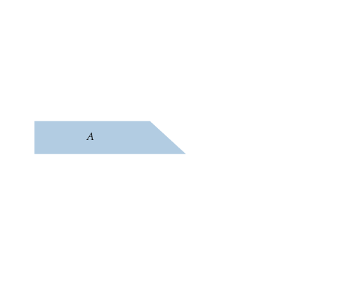
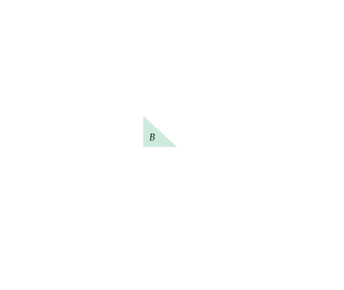
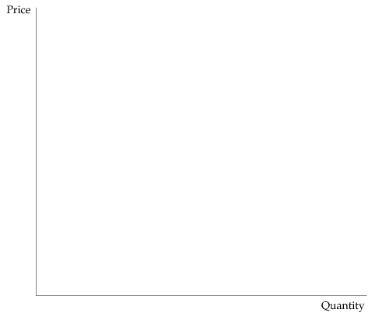
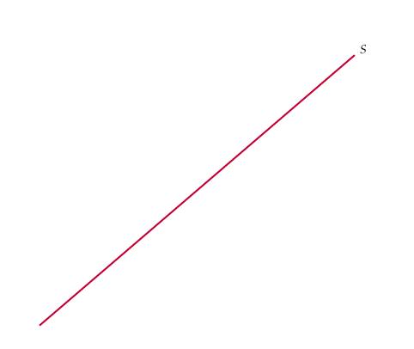
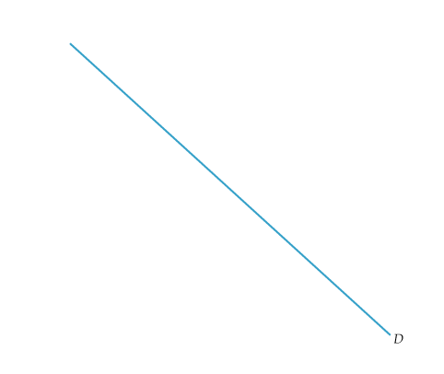
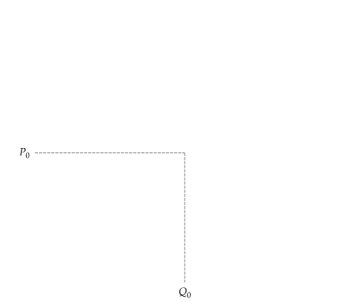
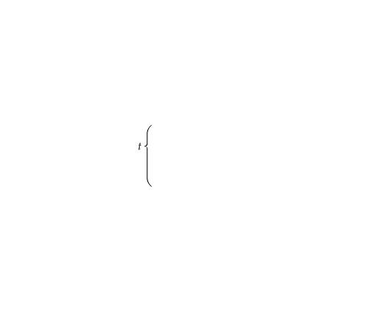
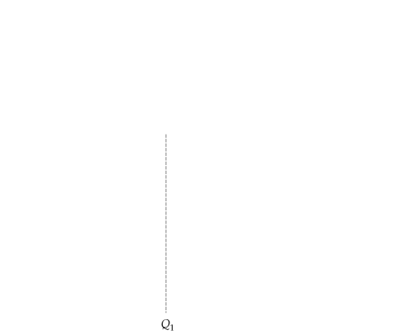



THE IMPACT OF A TAX OR SUBSIDY
● specific tax Tax of a certain amount of money per unit sold.
Incidence of a Tax
P_{b} is the price (including the tax) paid by buyers. P_{s} is the price that sellers receive, less the tax.
Here the burden of the tax is split evenly between buyers and sellers.
Buyers lose A + B.
Sellers lose D + C.
The government earns A + D in revenue.
The deadweight loss is B + C.
Market clearing requires four conditions to be satisfied after the tax is in place:
Q^{D} = Q^{D}(P_{b}) (a)
Q^{S} = Q^{S}(P_{s}) (b)
Q^{D} = Q^{S} (c)
P_{b} − P_{s} = t (d)

Slide 9
















THE IMPACT OF A TAX OR SUBSIDY
Impact of a Tax Depends on Elasticities of Supply and Demand
(a) If demand is very inelastic relative to supply, the burden of the tax falls mostly on buyers.
(b) If demand is very elastic relative to supply, it falls mostly on sellers.

Slide 10







THE IMPACT OF A TAX OR SUBSIDY
The Effects of a Subsidy
● subsidy Payment reducing the buyer’s price below the seller’s price; i.e., a negative tax.
Conditions needed for the market to clear with a subsidy:
Q^{D} = Q^{D}(P_{b}) (a’)
Q^{S} = Q^{S}(P_{s}) (b’)
Q^{D} = Q^{S} (c’)
P_{s} − P_{b} = s (d’)
A subsidy can be thought of as a negative tax. Like a tax, the benefit of a subsidy is split between buyers and sellers, depending on the relative elasticities of supply and demand.

